Slide 1
Principles of Data Science
Li Niu

Slide 2








How to measure the distance?
y
y
x
-
x
= Euclidian distance of 5 units
-
= Gray value distance of 50 values
-
= ?

Slide 3
Distance between two samples
Distance between two distributions

Slide 4
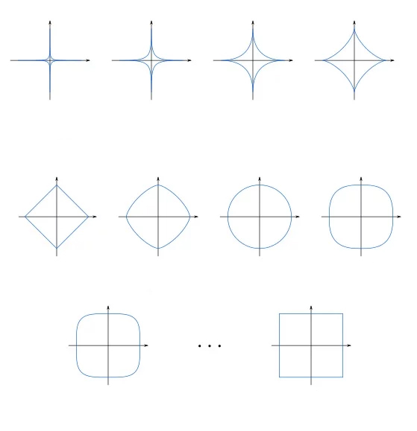
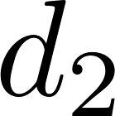
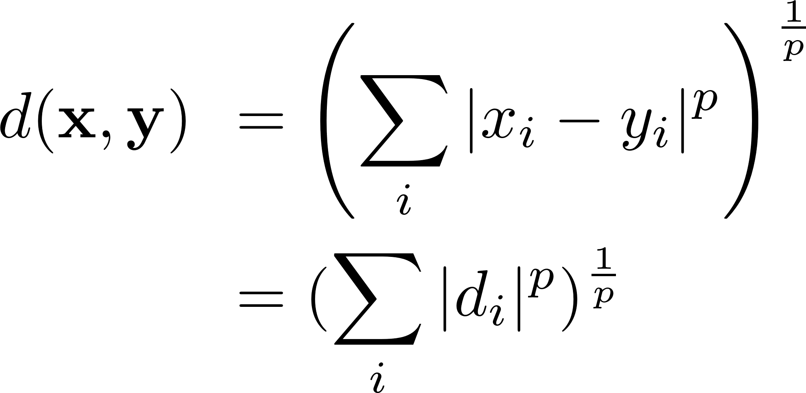
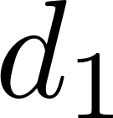
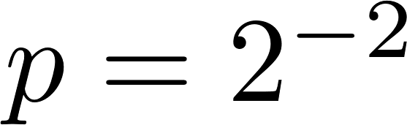
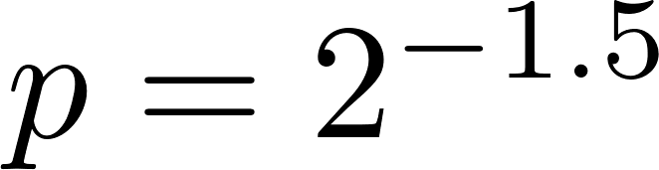
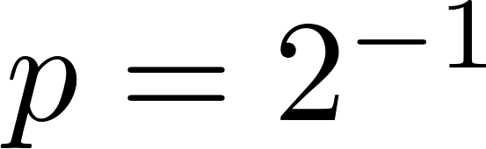
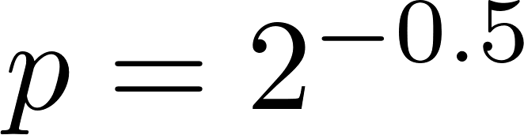
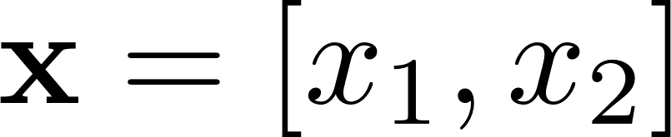
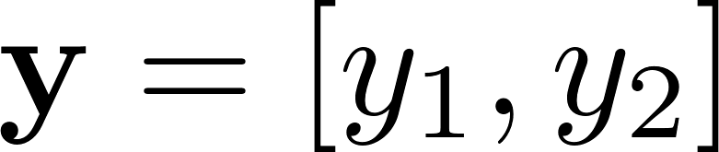
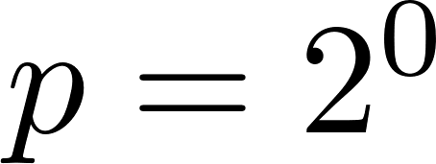
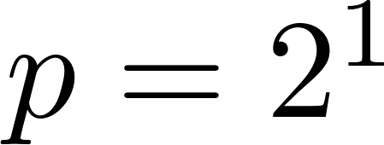
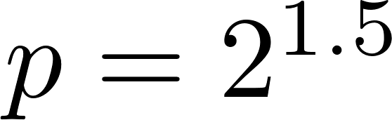
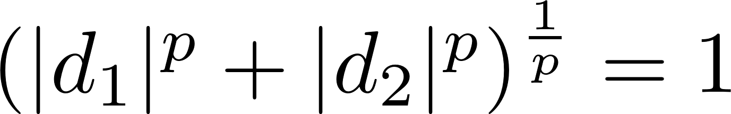
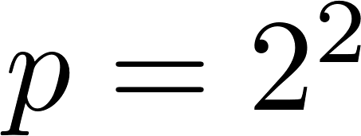
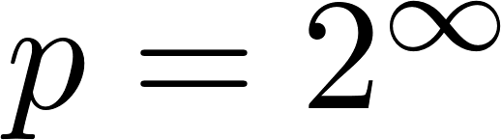
Minkowski distance

Slide 5
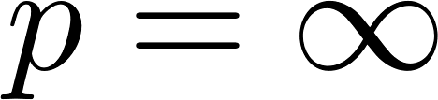
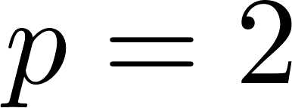
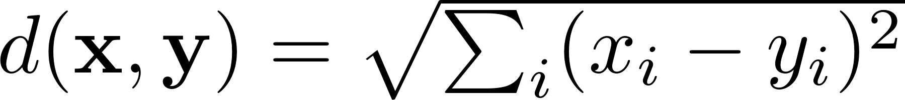
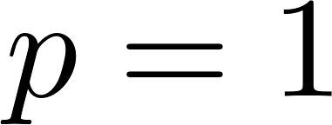
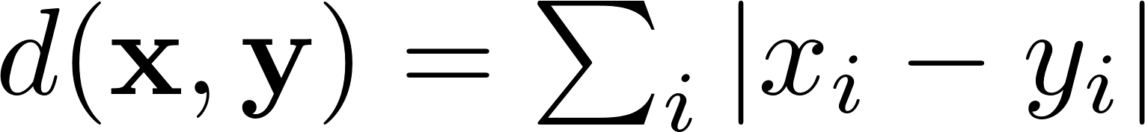
Minkowski distance
When
Chebyshev distance:
When
Euclidean distance:
When
Manhattan distance:

Slide 6

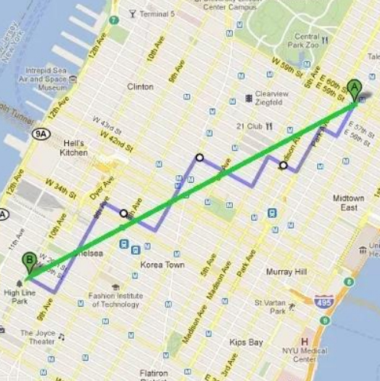
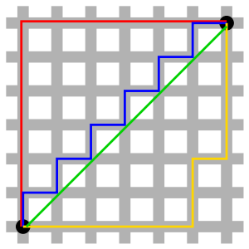

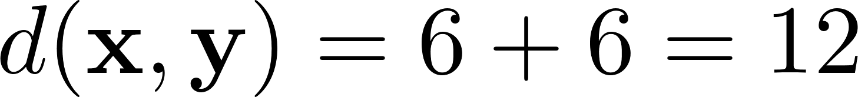
Manhattan distance
When
Manhattan distance:
Manhattan (city block) distance:

Slide 7
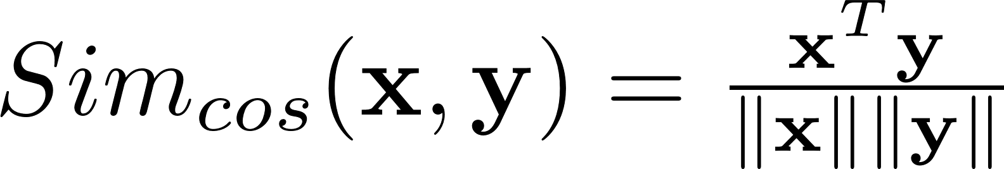
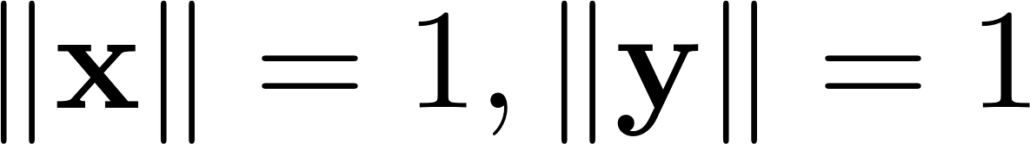
Cosine distance
When

Slide 8
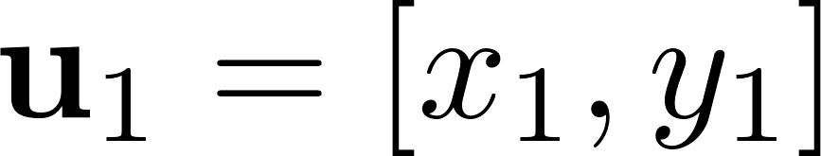
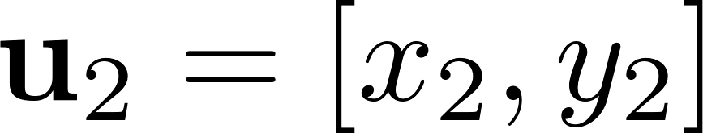
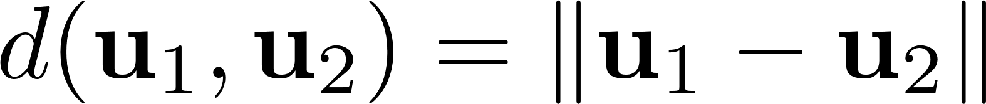
What if different dimensions are heterogeneous?
Person = [height (cm), weight (kg)]
is unreasonable

Slide 9
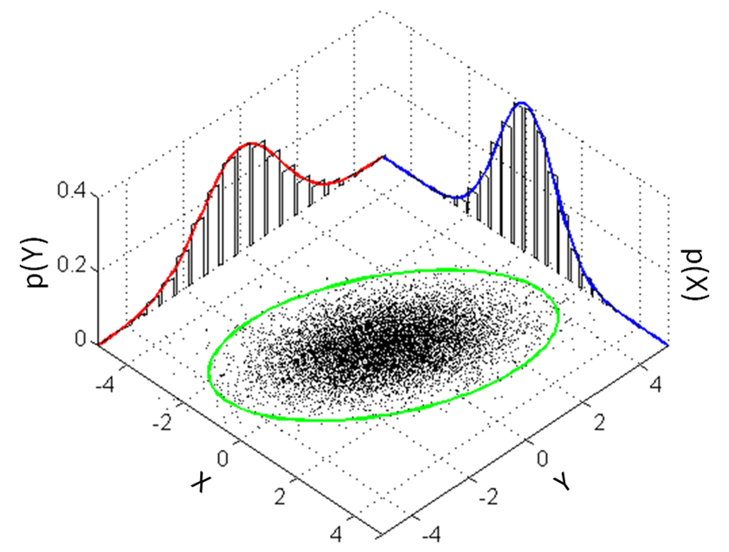
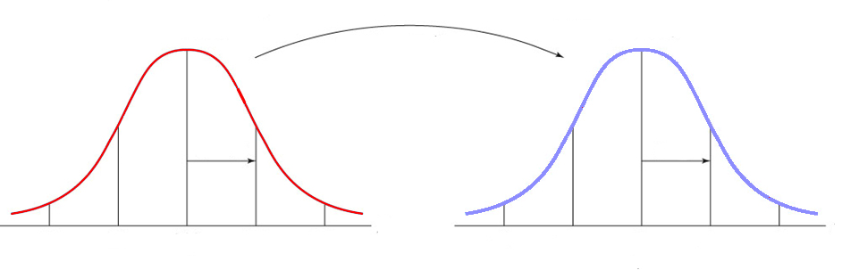
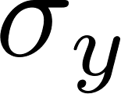

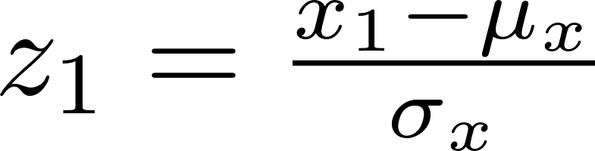
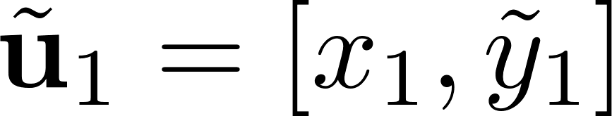
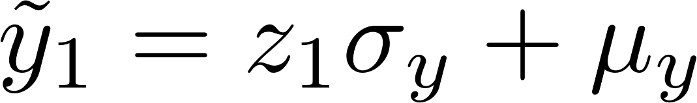
What if different dimensions are heterogeneous?
transform to
-4 -2 0 2 4
-2 -1 0 1 2
Z-score: the number of standard deviations between variable value and mean

Slide 10

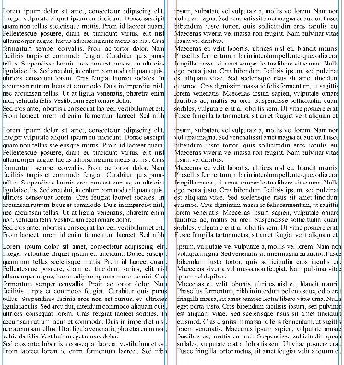
What if two samples are heterogeneous?
: visual feature
: textual feature

Slide 11
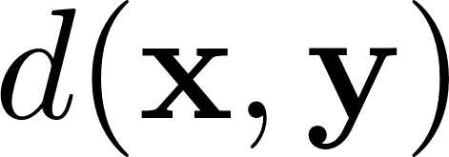
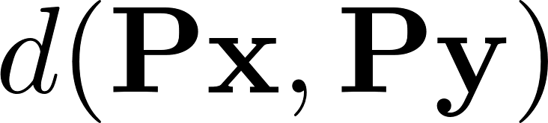
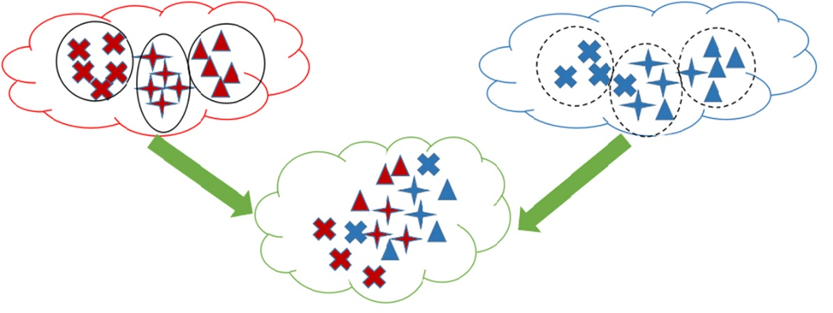
Metric learning
Project and to common space:
visual space
textual space
common space

Slide 12
Metric learning
Mahalanobis distance: extension of Euclidean distance
Euclidean distance:
Mahalanobis distance:

Slide 13

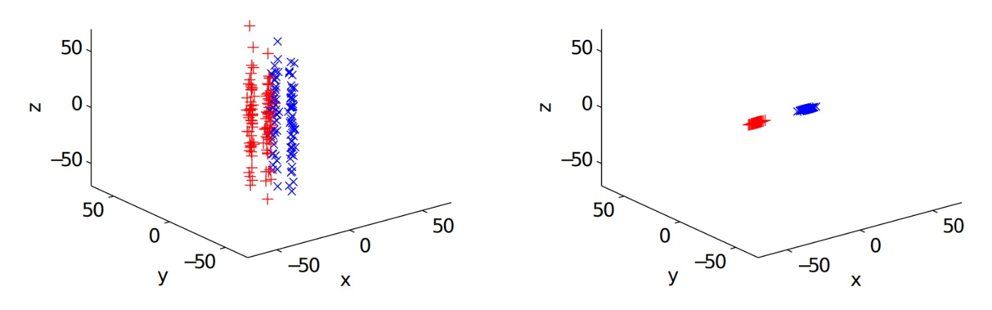
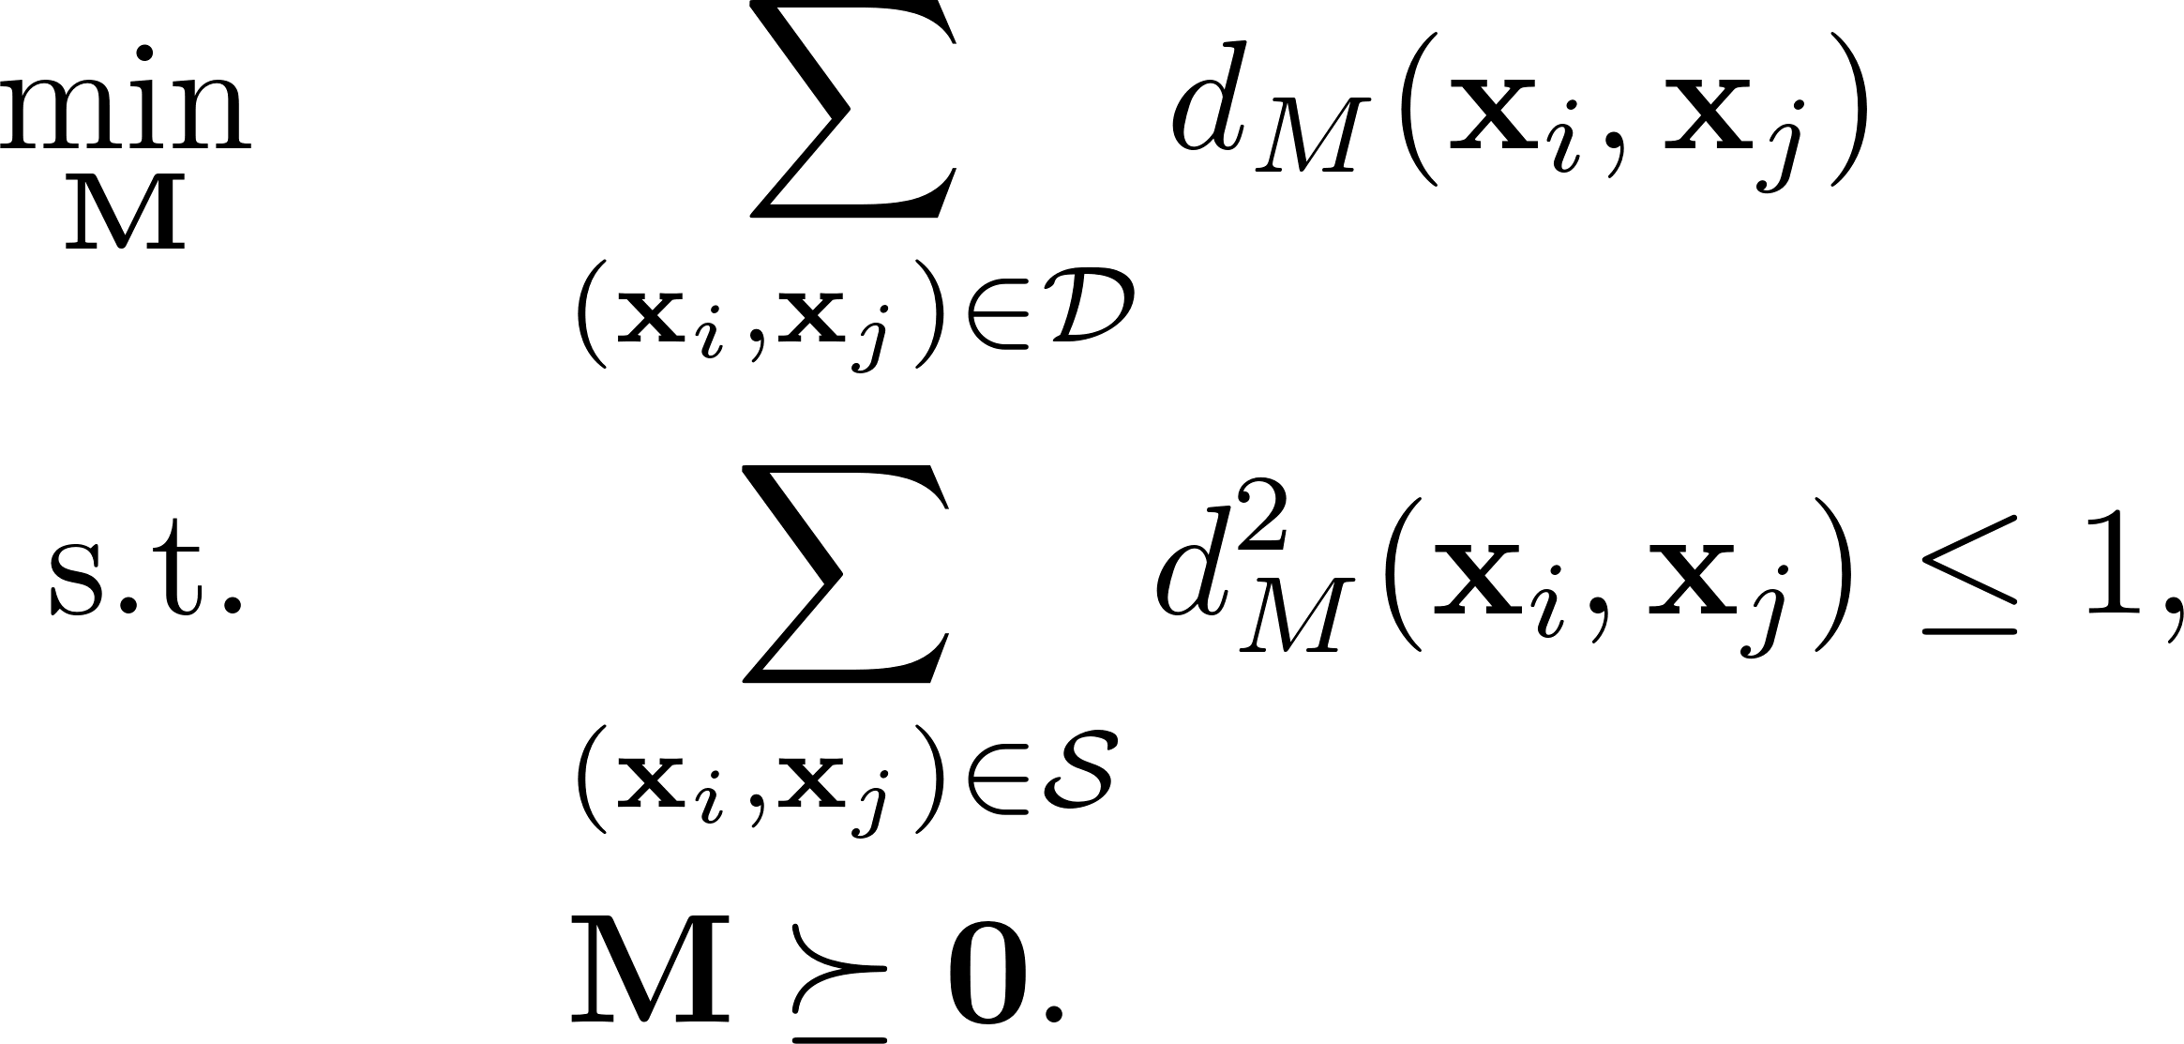
Metric learning
Set a goal of learning : enhance cluster coherence and separation

Slide 14
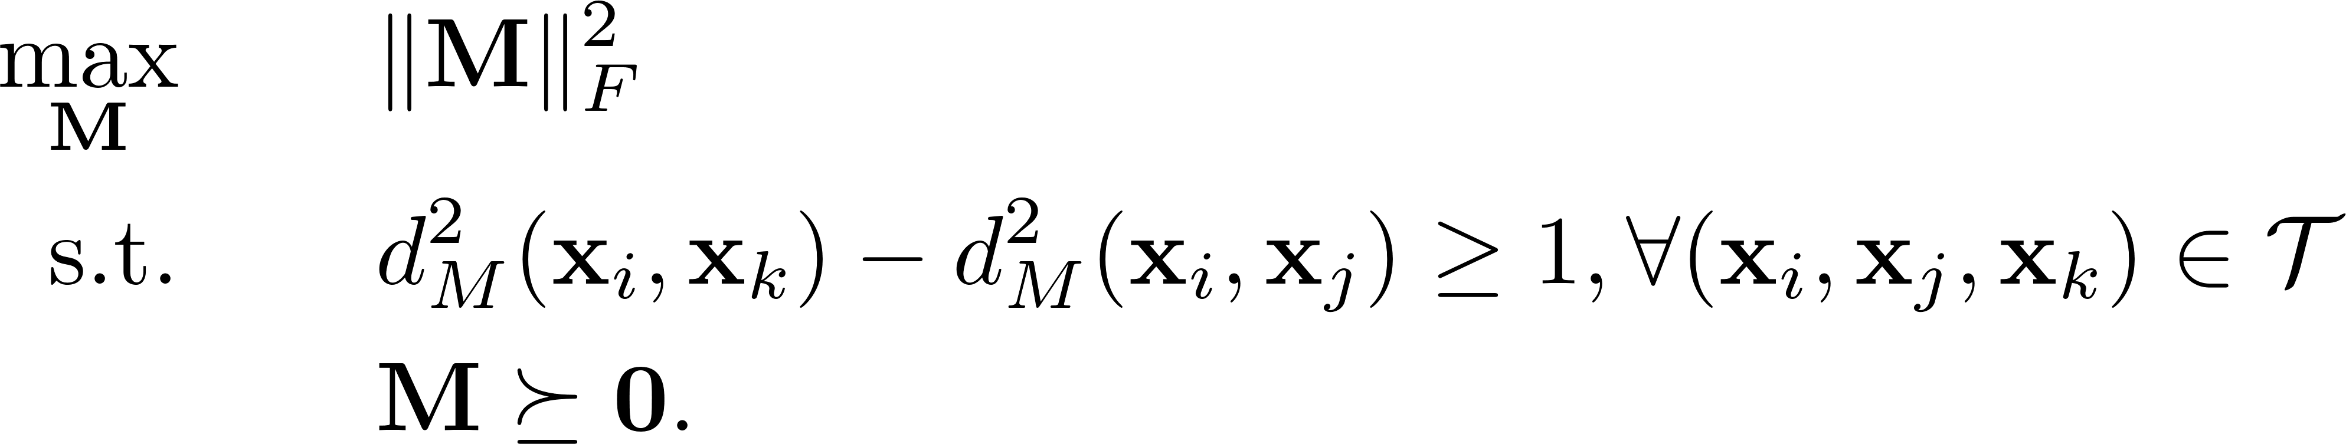
Metric learning
Set a goal of learning : enhance cluster coherence and separation

Slide 15


Earth Mover’s Distance (EMD)
How to compute the distance between and ?

Slide 16

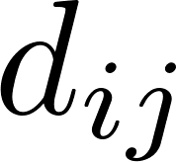
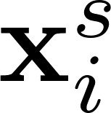
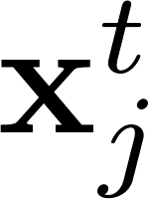
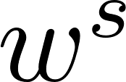
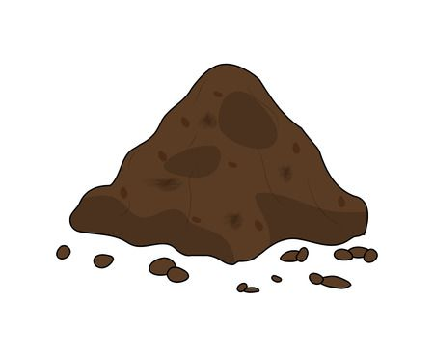

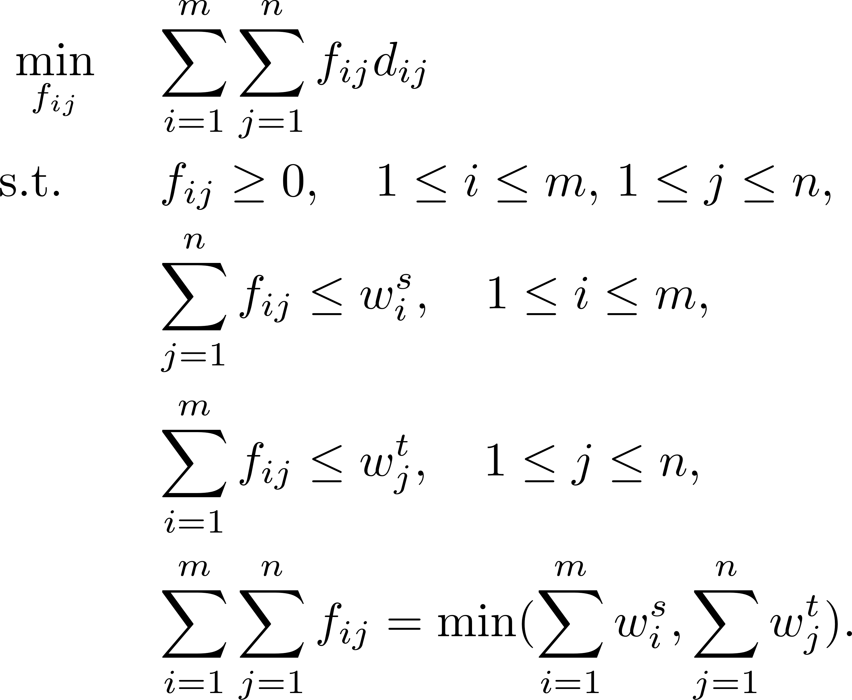
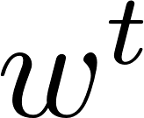



Earth Mover’s Distance (EMD)
is calculated based on and
…
…

Slide 17
Application of distance
Classification: KNN
Retrieval
Verification
Outlier detection

Slide 18
Retrieval
Which samples are closest to ?
: category A
: category B

Slide 19
Classification: KNN
Which category does belong to?
: category A
: category B
k=3
k=6

Slide 20
Verification
Does each pair of samples belong to the same category?
: category A
: category B

Slide 21
Outlier detection
Which sample is an outlier?
: non-outliers
: outliers

Slide 22
Distance between two samples
Distance between two distributions

Slide 23







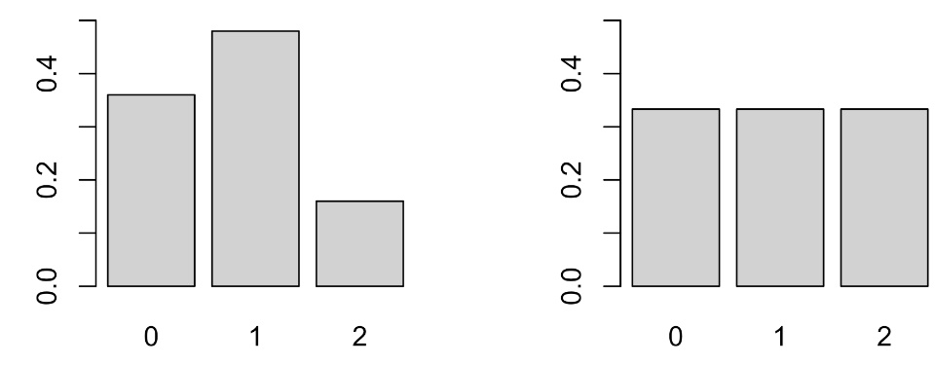
How to measure the distance between two distributions?
 | 0.36 | 0.48 | 0.16
 | 0.33 | 0.33 | 0.33

Slide 24



Compare two histograms
Canberra distance:
Chi-Square distance:
Intersection between two histograms:
....

Slide 25
Maximum Mean Discrepancy (MMD)
MMD

Slide 26

Kullback–Leibler (KL) divergence
cross-entropy
entropy

Slide 27


Extension of KL divergence
Jeffreys divergence:
Jensen-Shannon (JS) divergence:

Slide 28
Bregman divergence

Slide 29







Bregman divergence
When
Euclidean distance

Slide 30



Bregman divergence
When
generalized KL divergence

Slide 31
Thanks!

